Slide 1
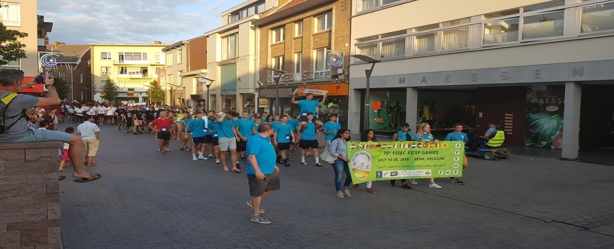
FICEP –FISEC GAMES, BUCHAREST ROMANIA 2019

Slide 2
FICEP-FISEC GAMES, BUCHAREST ROMANIA 2019
Organizers
Fédération Internationale Catholique d’Education Physique et Sportive (FICEP)
22 rue Oberkampf, F-75011 PARIS
Fédération Internationale Sportive de l’Enseignement Catholique(FISEC)
277, rue Saint-Jacques F75240. Cedex 05 -Paris
Host organisation
Asociatia Clubul Sportiv Roman (CSR)
Str. Novaci nr. 7 Bl. P52 Sc. 1 Ap 6, sect.5 051726, Bucharest Romania

Slide 3
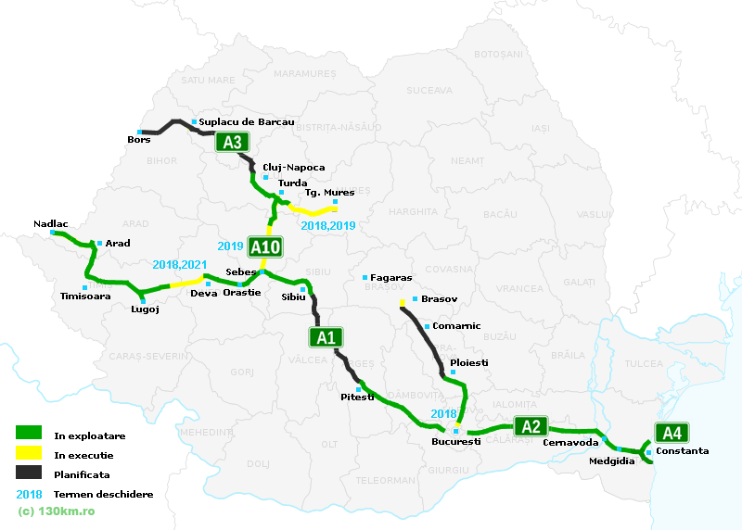
How to arrive
By plane: Henri Coanda International Airport is situated at 16 km away from the city center.
By bus: The main highway in Romania is A1 which has the entrance point in Nadlac at the border with Hungary
By train: The North
Railway station, is
Situated close to the city
Centre and has connection
With the Subway network.

Slide 4
Transport during the games
The transfer from and to the airport, will be done by special buses, depending on the flight schedule of each delegation.
The transport to the Sports Venues, will be done by special buses.
The participants, will receive public transport tickets.
For the officials, we will have mini buses.

Slide 5
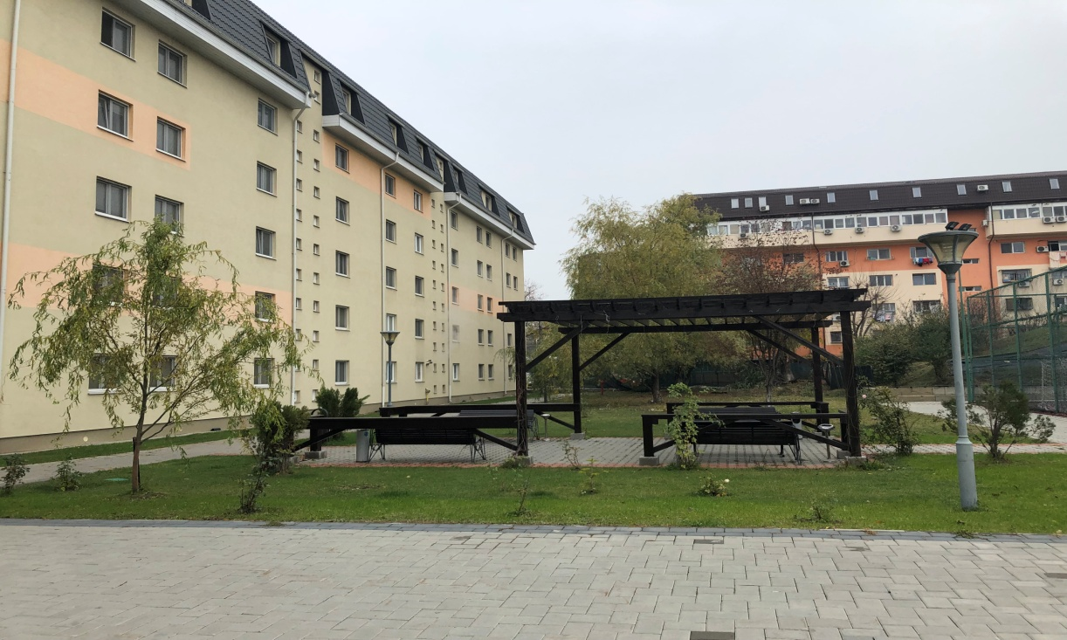
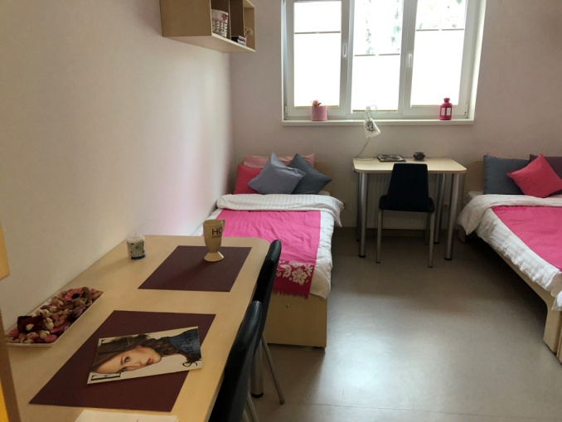
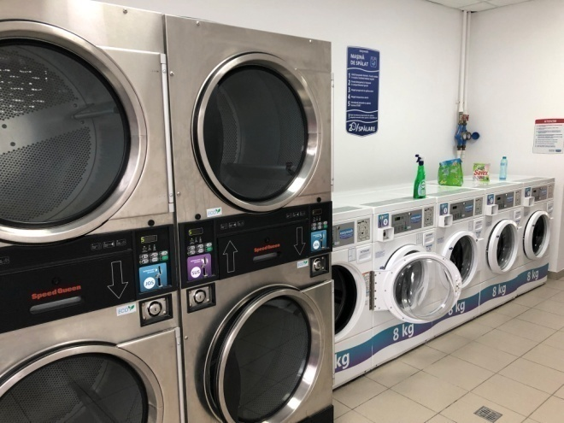
ACCOMMODATION AND MEALS
Accommodation of the participants will be in the University Campus Arcca, the biggest Private Campus in Bucharest, with a capacity of 2000 persons, out of which, 1000 will be available in July.
For the officials, the accommodation will be in a hotel.
All accommodation sites, have WI-FI inside the rooms.
For the particpants, there is also the possibility to wash the clothes for a price of 4 euro(not included in the participation fee)
Meals will be served at the accommodation site by a catering company
(breakfast and dinner) and the
lunch, close to each sports venue.

Slide 6
SPORTS VENUES
For the sports activities, we will use, the facilities from different parts of the city. for the following sports:
Swimming – indoor olympic pool Izvorani Olympic Centre
Volleyball - indoor hall, Izvorani Olympic Centre
Gymnastics - indoor hall, Izvorani Olympic Centre
Footbal – grass pitch, Agronomie
Basketball – Centrul Sportiv Apollo
Futsal - Sun Plaza Mall.
Table Tennis - Top Tennis Arena
Athletics - Stadium Iolanda Balasz Soter
Handball – indoor hall, Agronomie
All these sites are not fixed yet, it depends on the number of prticipants for each sport and are available to changes or replacements.

Slide 7
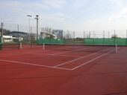
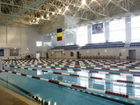
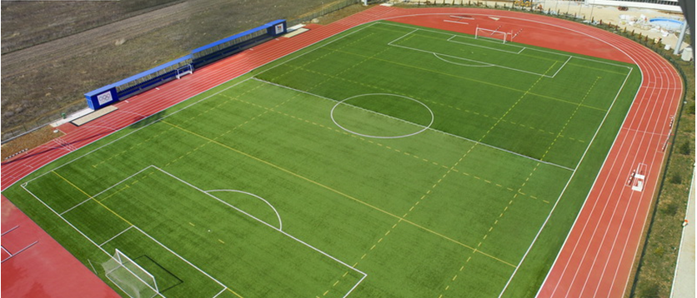
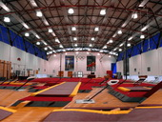
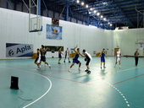
PICTURES OF THE SPORTS VENUES: IZVORANI

Slide 8
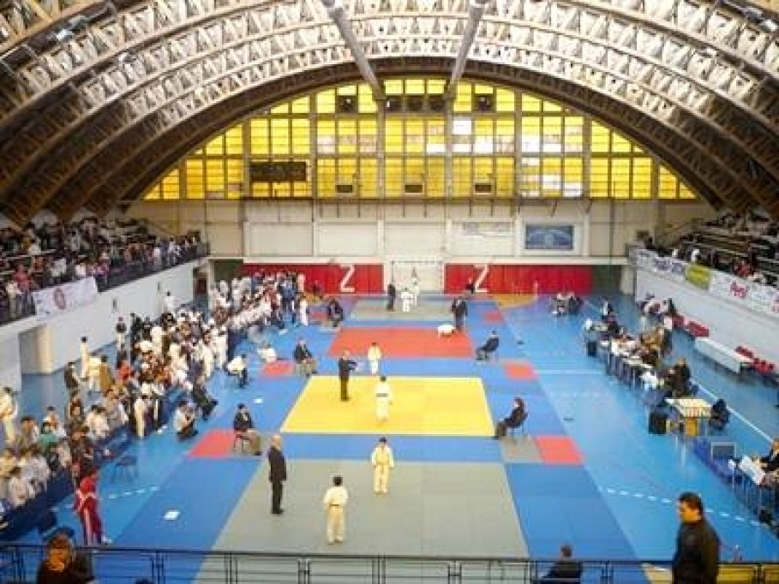
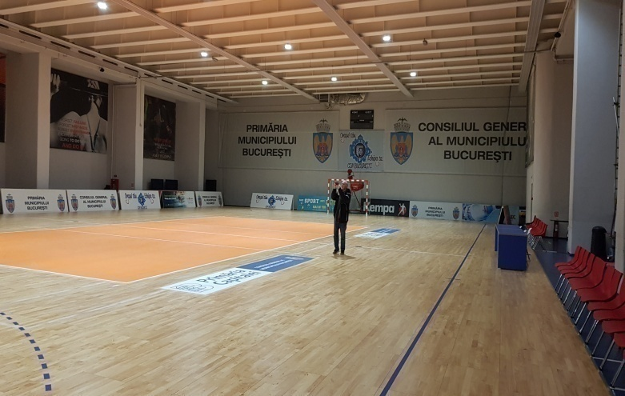
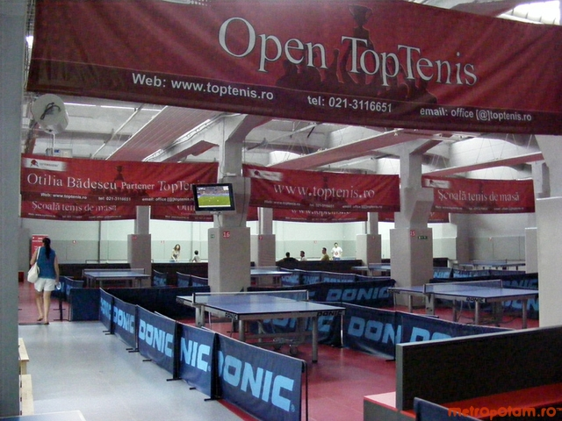
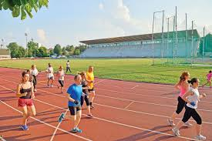
PICTURES OF THE SPORTS VENUES:

Slide 9
Communication
The official website of the games is www.ffgames2019.com It will be on-line by the end of December2018.
Besides the general info regarding the games, there will be a mini-site for each sport, which will contain all the teams, one profile for each player, all the fixtures, results, statistics, map of the sport venues, etc. We will try to update the results on-line after each game, depending on the internet capability at the sport venues.
Registration will be made directly on the site, with all the data of the participants and officials, including the upload of the pictures for the accreditation pass.
The accreditation pass will be on a PVC card and it will be printed directly with the picture, after the registration will be made. The cards will be given to the delegation leaders, after the check with the ID of the participants.
All the bulletins of the games will be on the site only(no printing). It will contain only the general info about the daily program, because the fixtures and results are already on the site.

Slide 10
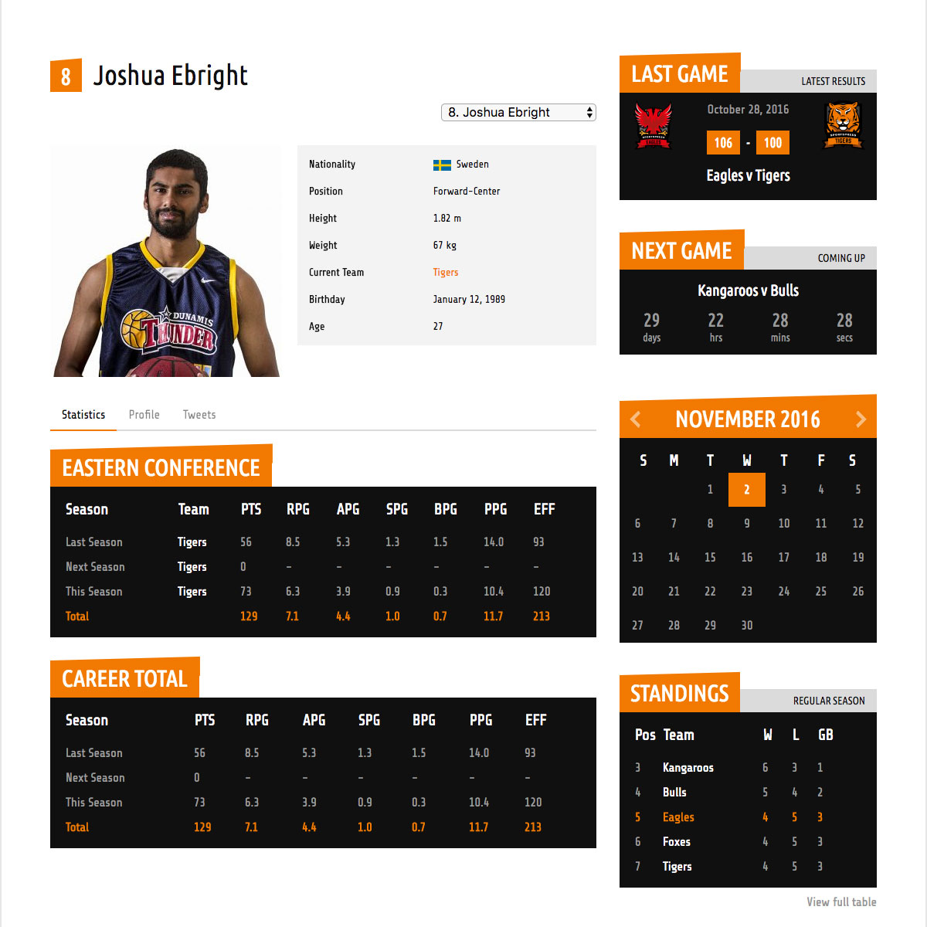
Communication

Slide 11
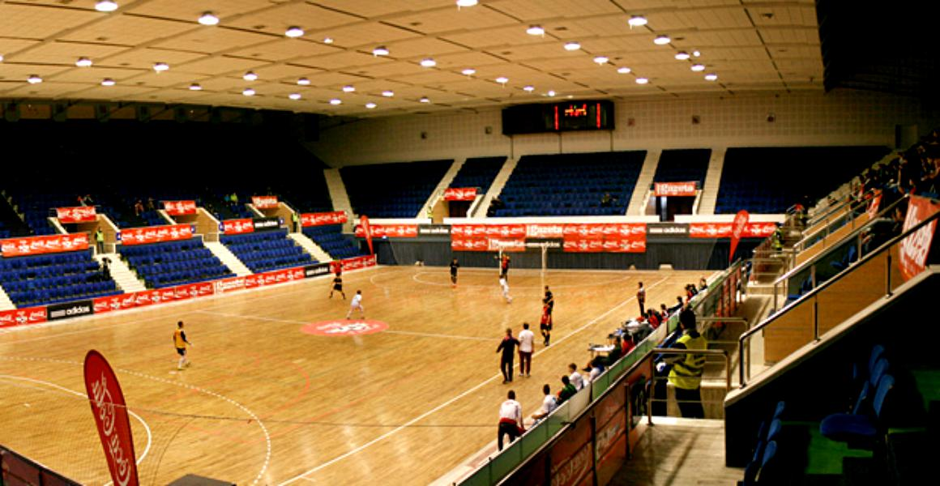
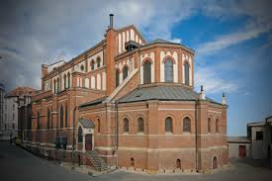
MASS, OPENING AND CLOSING CEREMONIES
The Holy Mass will be held in the Roman Catholic Cathedral of Bucharest, situated in the center of the city.
For the opening and closing ceremonies, we will use the Polyvalent Hall, situated close (15 minutes by bus) to the Accommodation site.
POLYVALENT HALL
CATHOLIC CATHEDRAL ST JOSEPH

Slide 12
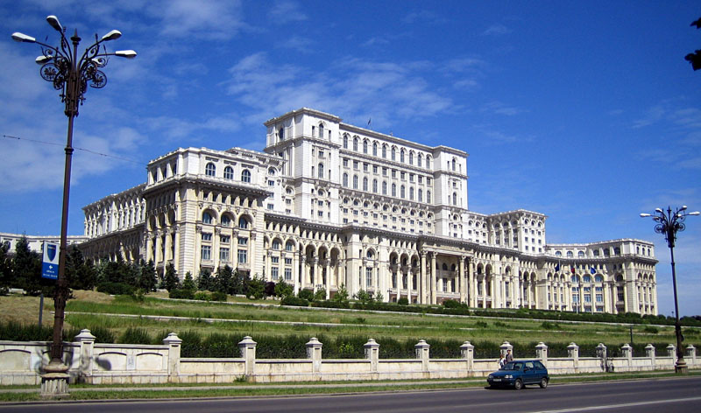
Youth Village and Bazar
Inside the Accommodation site, we will organize a stage for the evening program and the Youth Village for the participants.
For the cultural evening, we propose to have a short program(10 minutes), made by the participants of each country, which can be a dance, a song or anything else specific to the country.
During the Games, all the participants and officials, will visit the Palace of the Parliament.
The Youth Forum and the Bazaar, will take place at the accommodation site.

Slide 13
See you in Bucharest!

